Slide 1
On Testing Machine Learning Programs https://arxiv.org/pdf/1812.02257.pdf
[Model]
Conceptual Error : Serving 데이터의 분포와 Training 데이터의 분포 차이를 최소화 하는 것이 목적.
이것의 차이로 발생하는 문제점을 찾는 테스트 영역. 주로 코너 케이스(발생할 확률이 매우 낮은)의 Counter Example 을 찾는 방법을 사용.
그러나 해당 Counter Example 의 대표성(의미)를 부여하는 것이 어렵고, 이것을 Model Robustness 또는 Vulnerability 로 설명하고 있음
즉, Robustness 가 크게 필요한 Mission Critical System 에 적용하는 것이 적합하지 않을까 함.
단, 이런 문제를 해결하기 위해 real world 에서 발생할 수 있을 법한 input 을 만들어내는 연구는 진행되고 있음
모델, 학습 데이터 정보의 가용성에 따라 Black Box, White Box → 이것보다는 Adversarial Attack , Metamorphic Testing 으로 구분하는 것이 더 좋을 듯
Black box testing : counter example 의 representativeness 문제 → 결국은 robustness 가 중요한 영역에 적용하는 것이 적합
e.g., DeepFool : a simple and accurate method to fool deep neural networks https://www.cv-foundation.org/openaccess/content_cvpr_2016/app/S12-10.pdf
White box testing
e.g., FGSM :
e.g., DeepXplore/DeepTest/DeepGuage : 입력 데이터를 사전 정의된 입력 요구사항 범위내에서 변형하는데 무한한 변형 인스턴스가 발생하므로
모델의 연산자 방문 커버리지를 증가시키는 경우 이를 Test Case 로 정의하고, 해당 Test Case 가 사전 정의된 출력 요구사항 범위를 초과 시키는지 체크
Implementation Error : ML 알고리즘은 mathematical formula 로 정의되고 모델을 구현하는 것은 formula 를 코드로 작성하는 것.
formula 와 written code 의 차이로 발생하는 문제를 찾는 테스트 영역
Property based testing
Testing MCMC code https://arxiv.org/pdf/1412.5218.pdf
Metamorphic testing – a kind of property based testing
Identifying Implementation Bugs in Machine Learning Based Image Classifiers using Metamorphic Testing
https://arxiv.org/pdf/1808.05353.pdf / https://github.com/verml/VerifyML/blob/master/verML_appendices_v0.4.pdf
Fuzz testing (& Differential testing)
TensorFuzz : finding NaNs in tensors , generating divergences between org model and customized model, etc http://www.augustusodena.com/assets/tensorfuzz_icml_slides.pdf
Proof Based Testing
http://proceedings.mlr.press/v70/selsam17a/selsam17a.pdf
[Data]
훈련 데이터의 의미적, 통계적 오류를 발견하여 수정을 유도하거나 시장데이터와의 차이를 발견하는 방법
Data Linter : http://learningsys.org/nips17/assets/papers/paper_19.pdf
DATA VALIDATION FOR MACHINE LEARNING https://www.sysml.cc/doc/2019/167.pdf

Slide 2
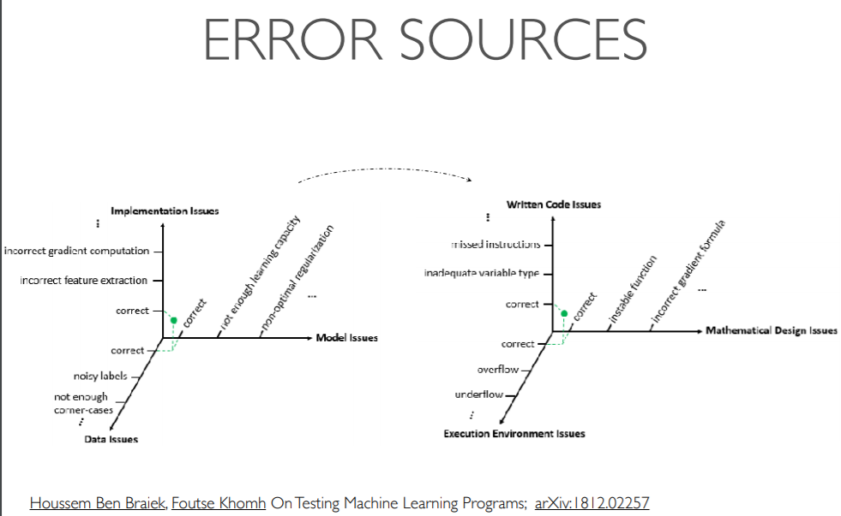

Slide 3
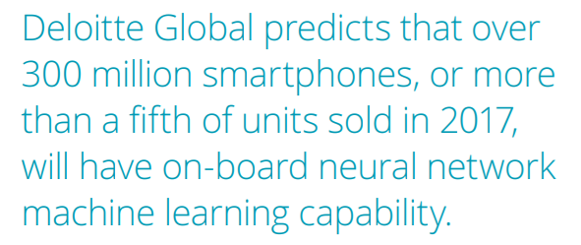
https://arxiv.org/pdf/1809.03559.pdf
According to the report from Delloitte [7], the penetration of ML-featured applications among mobile application used by adult users in developed countries surpasses 60%. Machine learning will become a core element of future mobile devices
[7] Technology, media and telecommunications predictions
https://www2.deloitte.com/content/dam/Deloitte/global/Documents/Technology-Media-Telecommunications/gx-deloitte-2017-tmt-predictions.pdf
Forbes, AI democratization 키워드 검색

Slide 4
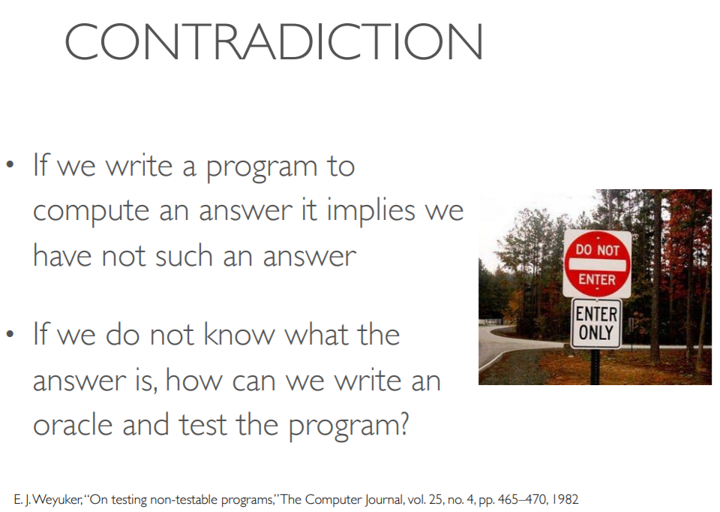
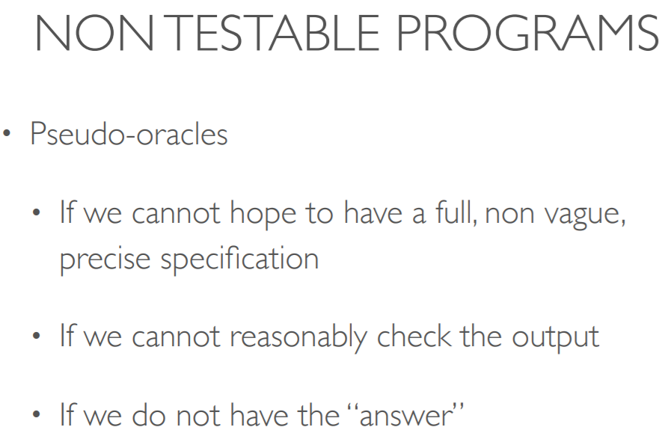
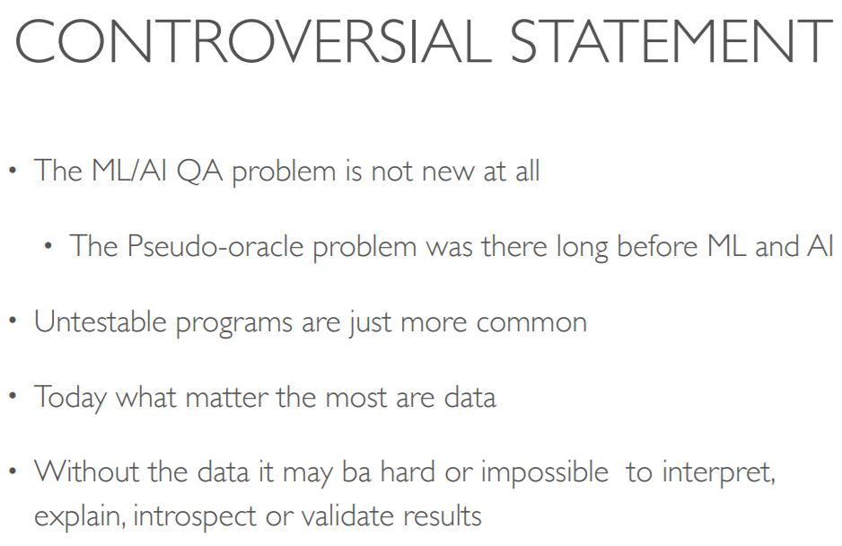
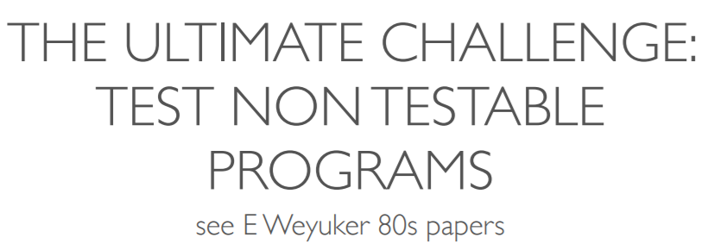
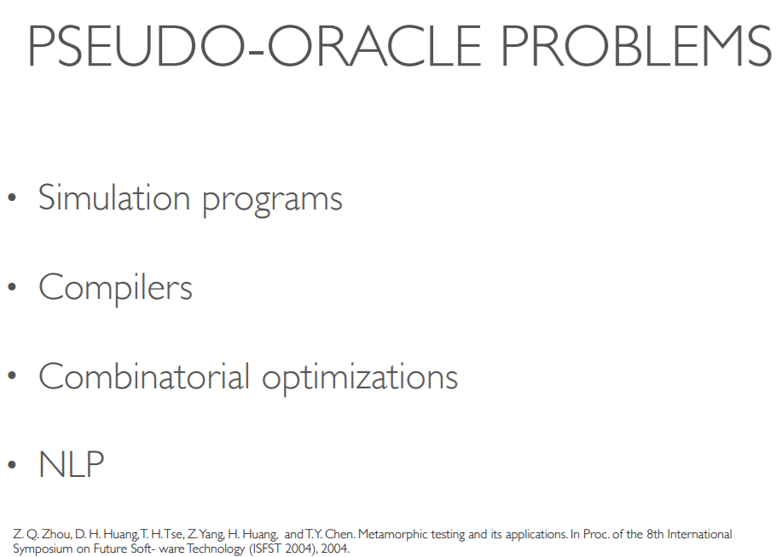
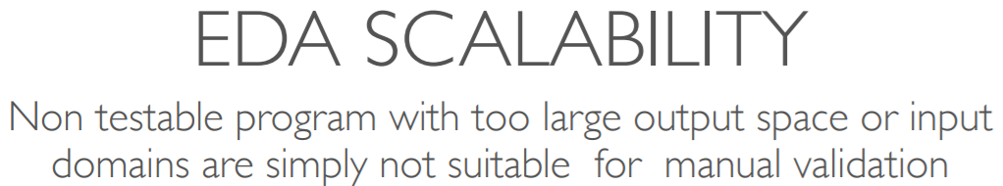
http://research.nii.ac.jp/iMLSE/SEMLA.pdf

Slide 5
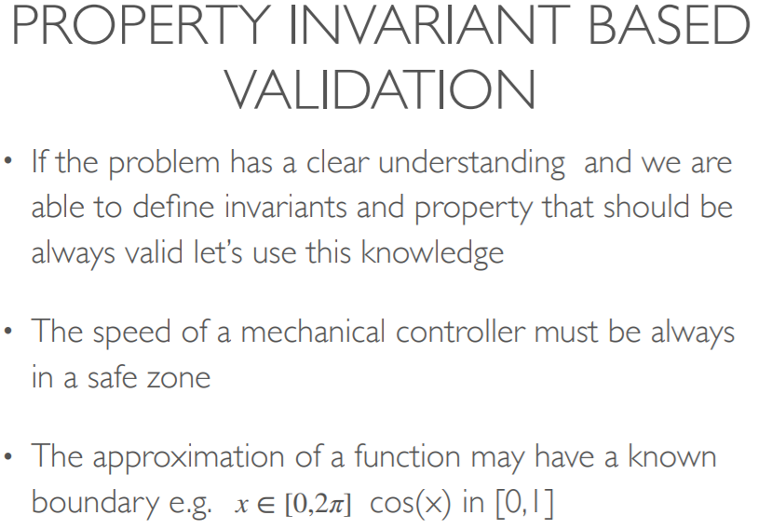
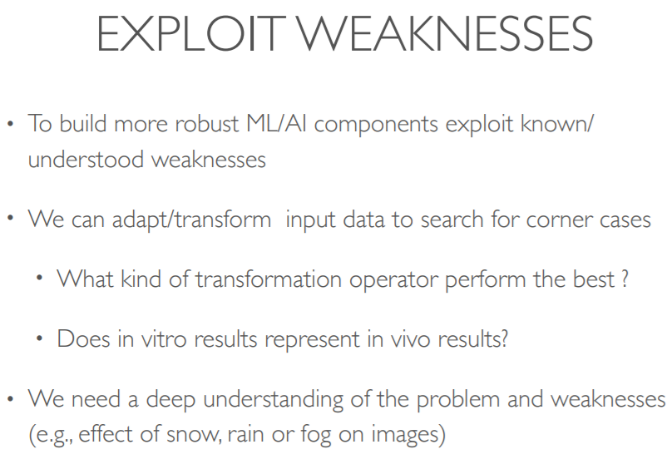
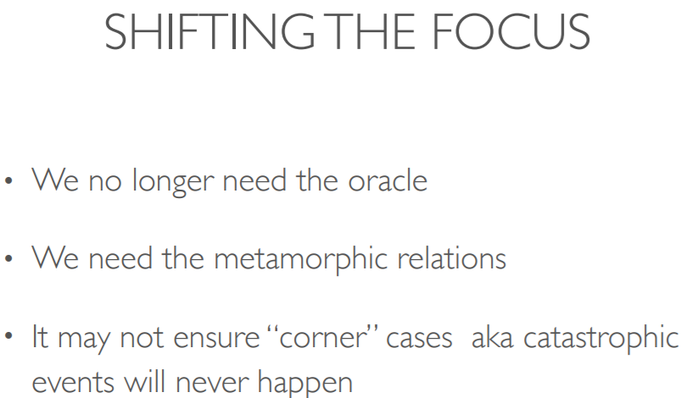
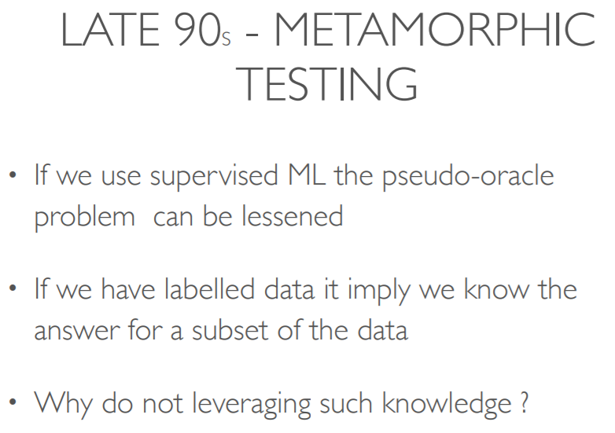
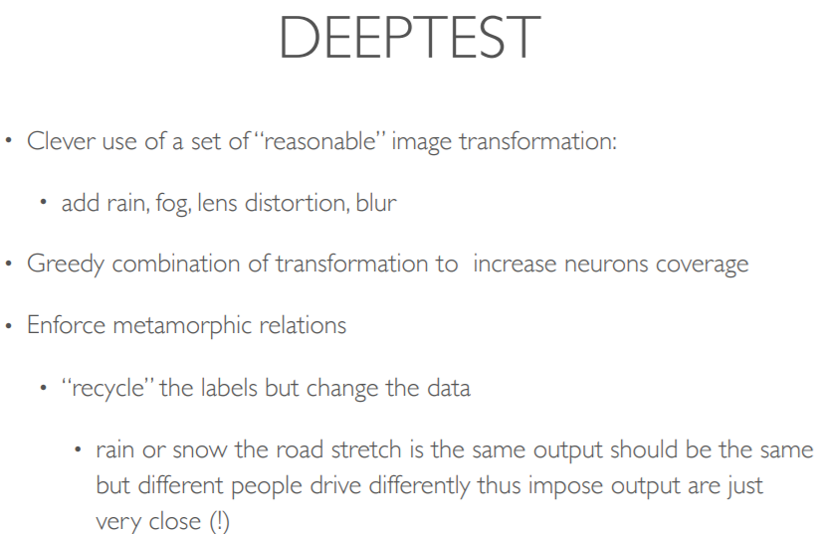
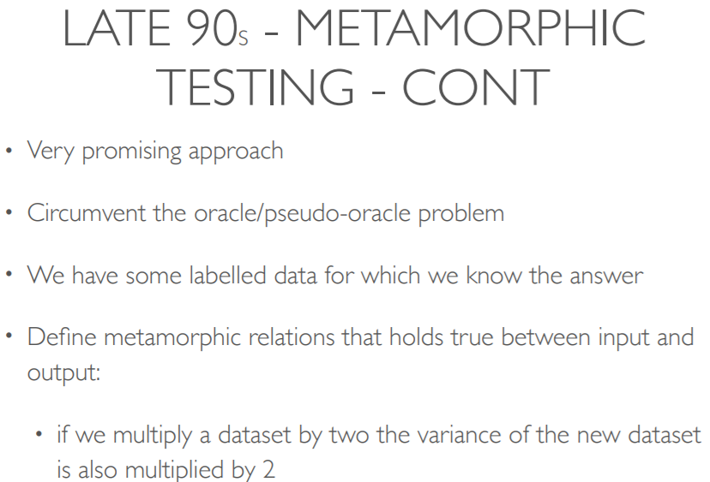

Slide 6
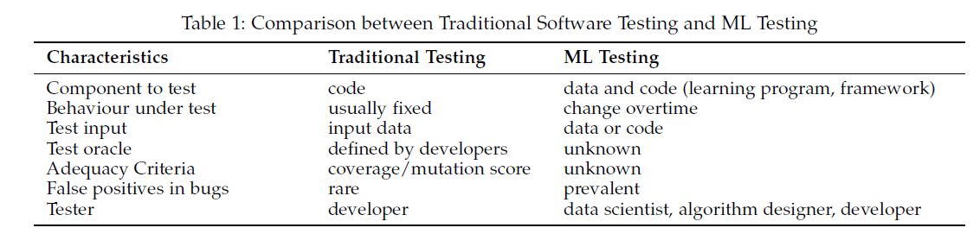
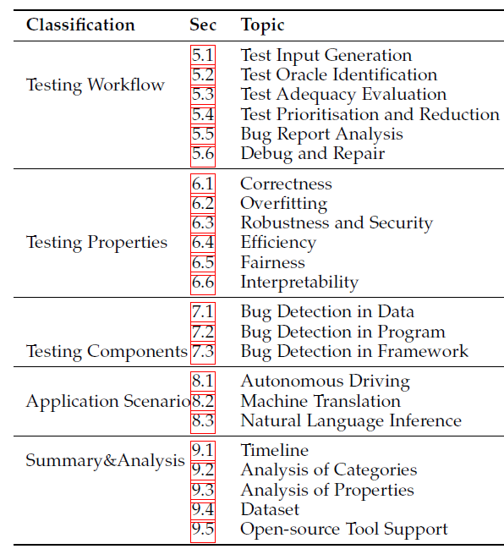
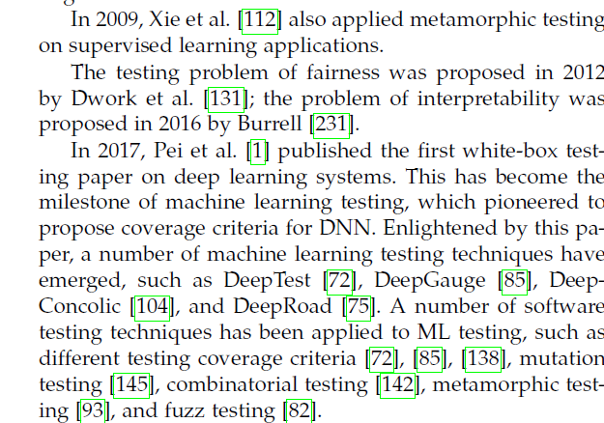
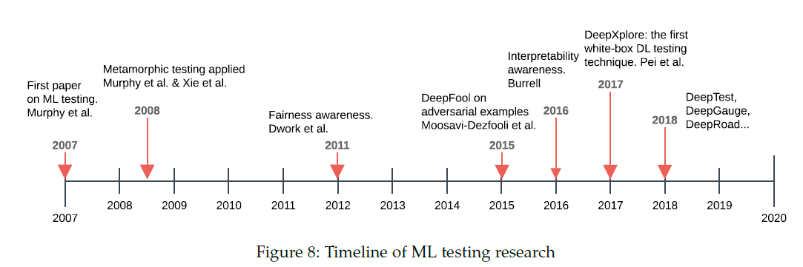
https://semla.polymtl.ca/wp-content/uploads/2019/05/Zhang-semla.pdf
https://arxiv.org/pdf/1906.10742.pdf

Slide 7
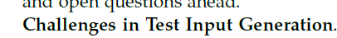
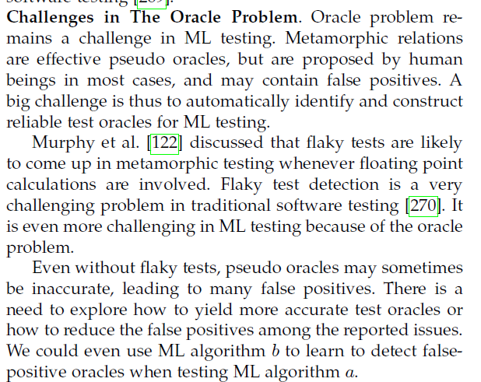
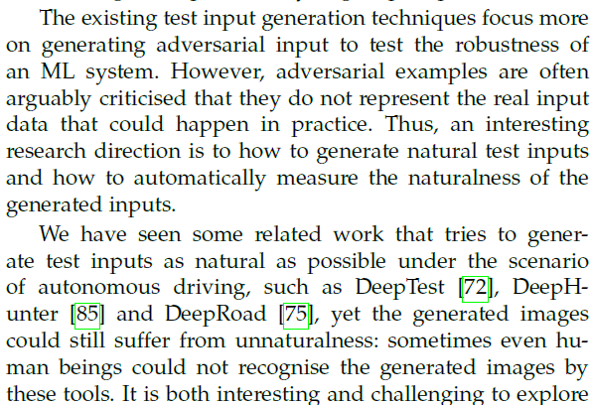
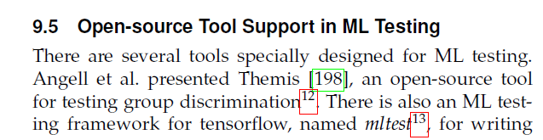
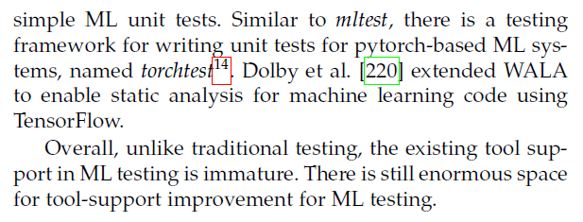
Ariadne: Analysis for machine learning programs

Slide 8
http://learningsys.org/nips17/assets/papers/paper_19.pdf

Slide 9
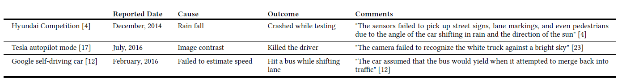
1. Definition, Objectives of DeepTest
Systematically explore different parts of the DNN logic by generating test inputs that maximize the numbers of activated neurons.
2. Background
① why this is needed?
The existing mechanisms for detecting such erroneous behaviors depend heavily on manual collection of labeled
test data or ad hoc, unguided simulation [11, 20] and therefore miss numerous corner cases
② what makes difficulties to meet the objectives of ‘DeepTest’?
Unlike traditional software where the program logic is manually written by the software developers, DNN-based software automatically learns its logic from a large amount of data with minimal human guidance. In addition, the logic of a traditional program is expressed in terms of control flow statements while DNNs use weights for edges between different neurons and nonlinear activation functions for similar purposes
3. Strategy to overcomes the difficulties → 체계적 접근 위해선 coverage based testing 필요
a systematic technique to automatically synthesize
test cases that maximizes neuron coverage
realistic image transformations (contrast, etc.) can be used to generate synthetic tests that increase neuron coverage
implement the proposed techniques in DeepTest and use DeepTest to test three top DNN models
made the erroneous behaviors available at https://deeplearningtest.github.io/deepTest/.

Slide 10
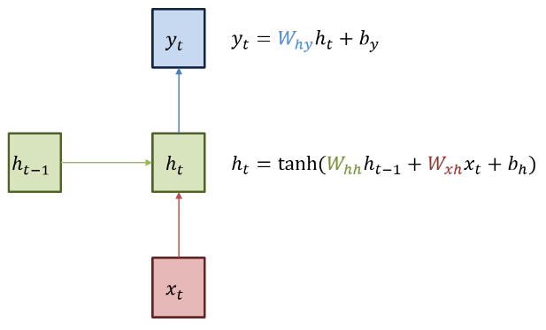
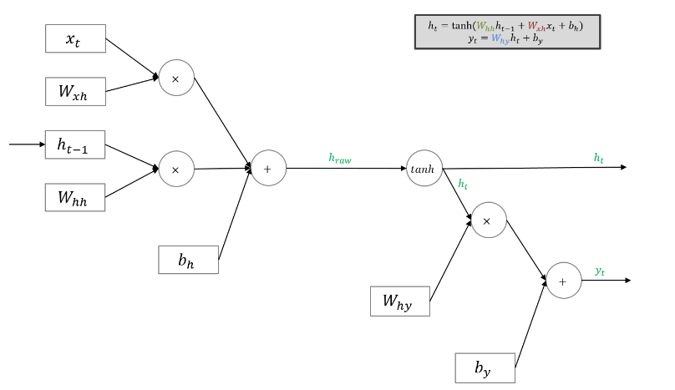
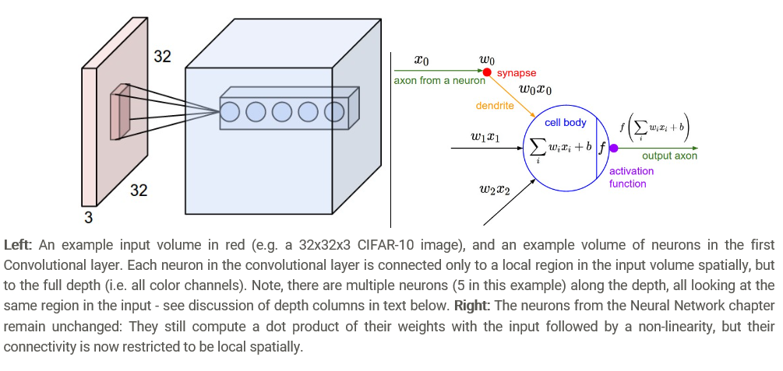
2. What is the DNN ? “DNN 구조는 유형별 다르나 neuron 은 가장 근본적 단위임을 피력”
① DNN 의 구성 요소 → 구성 방식에 무관
Each layer of a DNN consists of a sequence of individual computing units called neurons. The neurons in different layers are connected with each other through edges. Each edge has a corresponding weight (θs in Figure 2). Each neuron applies a nonlinear activation function on its inputs and sends the output to the subsequent neurons as shown in Figure 2.
② DNN 구성 방식 → 구성 방식에 따라 neuron 정의 방식과 세는 방식 다름
The neurons in a convolution layer are connected only to some
of the neurons in the next layer and multiple connections among different neurons share the same weight. The sets of connections sharing the same weights are essentially a convolution kernel
어떻게 feature 를 도출하는가에 따라 neuron 구성 다름
CNN
RNN

Slide 11
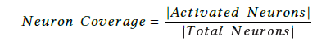
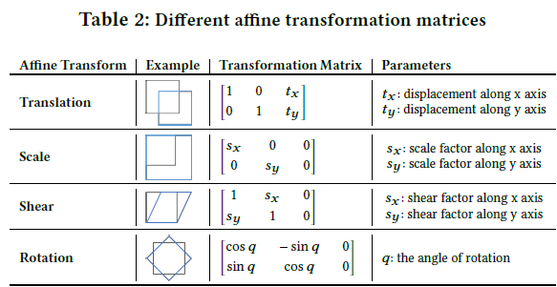
3. Methodology
fully-connected layers, we can directly compare
their outputs against the neuron activation threshold as these neurons output a single scalar value.
① Neuron Coverage
we compute the average of the output feature map to convert the multidimensional output of a neuron into a scalar and compare it to the neuron activation threshold
An individual neuron is considered activated if the neuron’s output (scaled by the overall layer’s outputs) is larger than a DNN-wide threshold. In this paper, we use 0.2 as the neuron activation threshold for all our experiments.
For RNN/LSTM with loops, the intermediate neurons are unrolled to produce a sequence of outputs (Figure 3.2). We treat each neuron in the unrolled layers as a separate individual neuron for the purpose of neuron coverage computation.
② Image Transformation
③ Combining Transformations to Increase Coverage
the state space of all possible combinations of different
transformations is too large to explore exhaustively
We provide a neuron-coverage-guided greedy search technique for efficiently finding combinations of image transformations that result in higher coverage

Slide 12
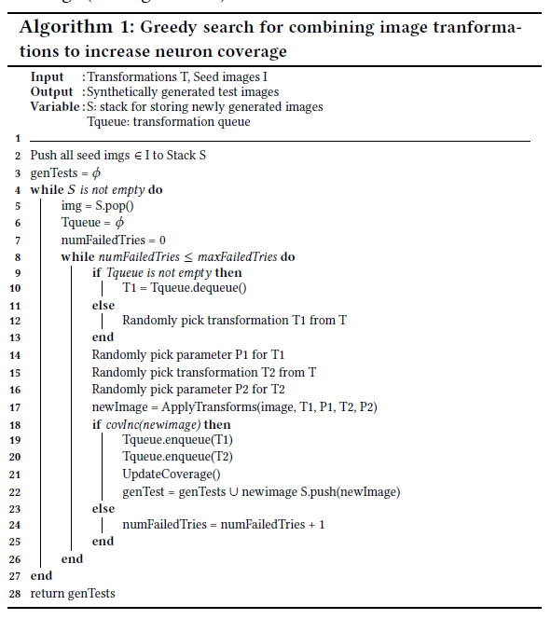
3. Methodology
③ Data gen
to Increase Coverage
Coverage 증대 시켰던 T₁ 을 고르고
T₂ 를 임의 선정해 Combination 해 입력 생성
해당 combination 이 coverage 증가시키면
T₂ 도 coverage 증가하는 것으로 간주
또한 해당 이미지를 coverage 증가 이미지로 간주해 모음
정해진 횟수만큼 반복

Slide 13
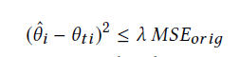
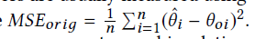
3. Methodology
④ Test Oracle
we leverage metamorphic relations [33] between the car behaviors across different synthetic images. The key insight
is that even though it is hard to specify the correct behavior of a self-driving car for every transformed image, one can define relationships between the car’s behaviors across certain types of transformations. For example, the autonomous car’s steering angle should not change significantly for the same image under any lighting/weather conditions, blurring, or any affine transformations with small parameter values.
there is usually no single correct steering angle for a given image, i.e., a car can safely tolerate small variations. Therefore, there is a trade-off between defining the metamorphic relations very tightly, like the one described above (may result in a large number of false positives) and making the relations more permissive (may
lead to many false negatives)

Slide 14
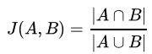
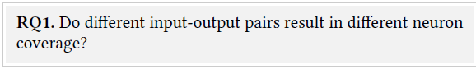
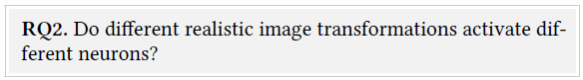
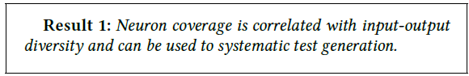
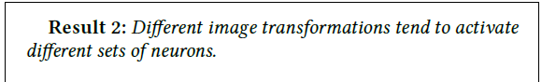
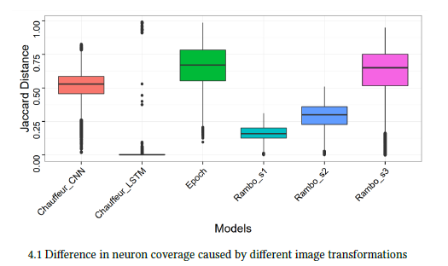
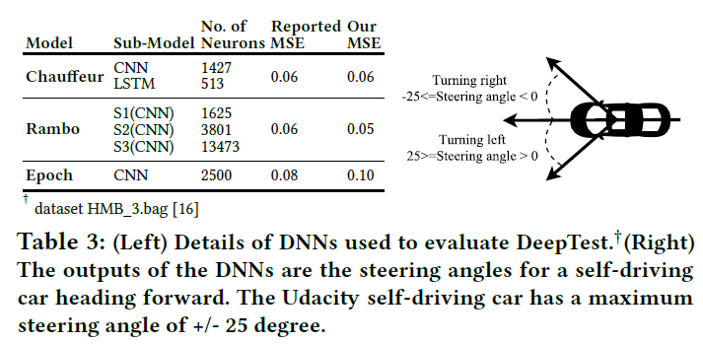
4. Evaluation
* 자카드 지수(Jaccard index)는 두 집합 사이의 유사도를 측정하는 방법
뉴런 커버리지가 갖은 경우 서로 다른 성격의 데이터 세트는 서로 다른 뉴런들을 커버하게 하는가?
높은 뉴런 커버리지를 갖는 데이터셋이 존재하는가?

Slide 15
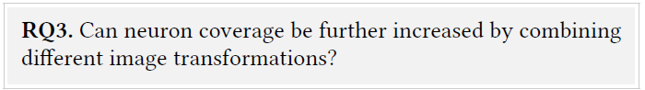
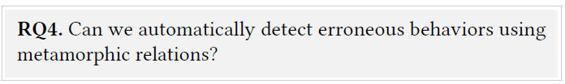
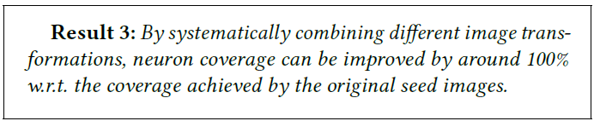
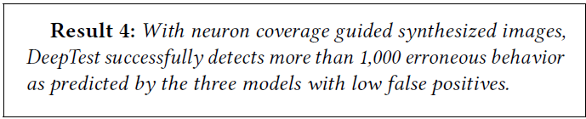
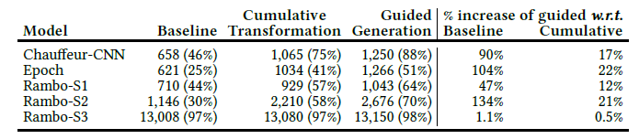
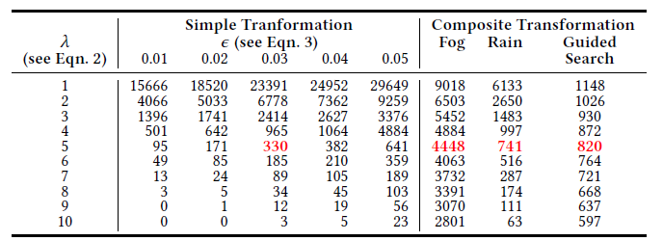
4. Evaluation
변형 함수 조합이 의미가 있는가? 즉, 단일 변형함수는 DNN 의 한 부분만을 커버할 것이라 예상되므로 조합을 통해 좀더 커버하게 만들 수 있는가?
결함은 잡히나? false positive 율은 밝히지 않네…
람다 값을 변형(메타모픽 관계 상세 정의)해서

Slide 16
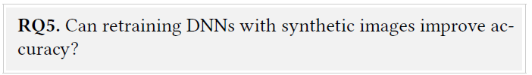
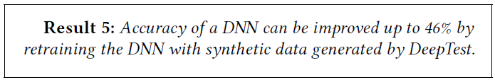
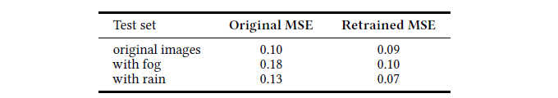
4. Evaluation
결함 발생 이미지가 아닌 생성 이미지 中 임의 선정 세트를 추가해서 학습해보니 정확도가 높아짐
Here we check whether retraining the DNNs with some of the synthetic images generated by DeepTest helps in making the DNNs more robust. We used the images from HMB_3.bag [16] and created their synthetic versions by adding the rain and fog effects. We retrained the Epoch model with randomly sampled 66% of these synthetic inputs along with the original training data. We evaluated
both the original and the retrained model on the rest 34% of the synthetic images and their original versions.

Slide 17
A Suggestion On Our Direction
esp., on the “Data Transformation (ML Based)”

Slide 18
우리는 ????
계획하고 있는 Test Data Generation 의 목적이 무엇이었지?
→ 데이터 만들기 어려우니,,생성하자!
Negative Test Case 생성이었던가?
→ 제약 조건하에서 변형 그리고 Coverage 를 증가시키는 방향으로 만들자!
가급적 현실적으로 보이는 데이터를 만들자!
그런데 여기서 잠깐만.. 생성 TC 가 FAIL 되면
어떻게 개발팀과 협업해서 품질 개선을 유도하지?
정확도 측정할 때 사용하는 데이터에 포함시켜서 수행해야 하나?
그리고 만든 데이터를 전달해주나?
그렇게 진행할 수 도 있을 것 같긴한데…
현실적이지 않은 데이터들은(노이즈 추가 등)….
뭔가 큰 시험 영역을 정의할 수 있다면 깔끔하지 않을까?

Slide 19
우리 마일스톤이 이거였나?
1st Phase
Data Generation
(Random /w constraint)
2nd Phase
Data Generation
(Coverage Guided)
3rd Phase
Data Generation
(ML Based ??)
?
“OpenCV based Transformation” is OK!
Linear, Affine, Convolutional, etc.
만들어진 것 중 Coverage 높이는 것만
추리는 것 OK!
ML Based 가 도체 모야?? GAN 이야? Attack 이야?? Adversarial Example 이야??
대강 멋진거 같아서 말은 그렇게 했는데…
여기에 대한 답을 찾고 싶음…정말로….근데 어려움!!!
오늘은 한발짝만!!! Step by Step !!!

Slide 20
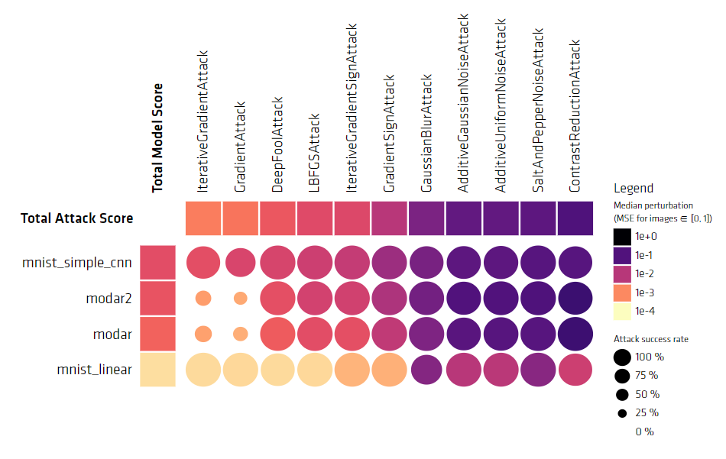
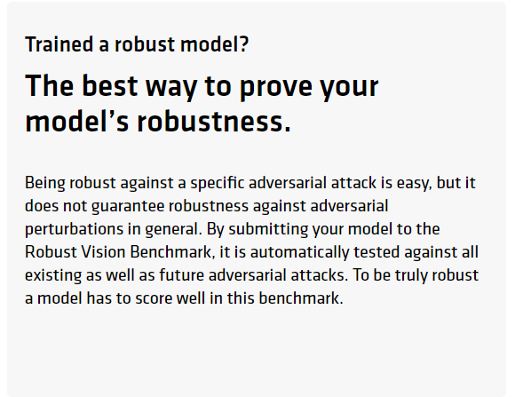

Background : Model 강건성 = Attack 과 Defense 가능성
Bench Marking 통한 강건성 상태 보여주기…..
강건하다고 증명하는 것은 아님!!!
(CWE 같은 것이 있다면 AI^2, Testing Deep Neural Network 주장 논리도 먹힐텐데..)
[Adversarial Attack for PyTorch]
- Fool Box : https://github.com/bethgelab/foolbox
- Benchmark the robustness of machine learning model : https://arxiv.org/abs/1707.04131
- Robust Vision Benchmark : https://robust.vision/benchmark/leaderboard/
- Operated by BETHGE LAB, 튀빙겐? 대학교 http://www.uni-tuebingen.de/
[Others…]
Cleverhans (Google)
https://arxiv.org/pdf/1610.00768.pdf
ART (IBM)
https://github.com/IBM/adversarial-robustness-toolbox

Slide 21



Background : 현존하는 Attack 과 Defense
Currently Hot 한 영역이니깐,,,, Attack 과 Defense 에 대해서 다소 체계적으로 정리하고 그 강도와 방어 가능성에 대해 서베이 및 실험을 진행함
Threat of Adversarial Attacks on Deep Learning in Computer : Survey , IEEE Access : https://arxiv.org/pdf/1801.00553.pdf
[attack 분류, 강도]
[defense 분류]

Slide 22
우리가 Robustness 를 품질 항목으로 추가한다면 ????
이러한 Attack 들 중에 어떤 것 부터 해야하지 ??
WhiteBox 방식으로 처음부터 하면 개발팀과 협업이 될까?
필요성부터 인지시켜야 할까??
그럴라면 현재 주어진 것으로 적용할 수 있는 방법은 ???
즉, 블랙박스로 접근해서 필요성 인지시키고, 그 다음에 화이트 박스 적용하는 것이 좋지 않을까?
만약 face verification 에 adversarial example 을 찾으면 ??
내가 아닌 사진을 나로 인식하게 network 를 fooling 하면?? 쫌 필요성이 고취될까?

Slide 23



Practical Black-Box Attacks against Machine Learning
ASIA CCS '17
Overall Theme : Able to generate adversarial example only with black-box information
under the contextual condition
has no information about the structure or parameters of the DNN
does not have access to any large training dataset
perturbation
under the practical condition
M/L model service is given by the Open API
observing output class labels, the number of labels queried,
the approach applies and scales to different ML classifier type
/w proposed
technique
STOP 표지판
인지
Yield 표지판
인지
with the below attacking model
DNN system outputs “probability vector” /w fixed number of categories
The determined label is the index of the class assigned the largest probability by the DNN → X [0.1, 0.4, 0.23, 0, 0.44] one-hot encoding
The output label set is only accessible, unable to access all the set of labels.
Desire to produce a minimally altered version of any input
label set known to us
perturbation, aka., noise
adversarial sample
(different term…ㅋㅋ)

Slide 24




Practical Black-Box Attacks against Machine Learning
일반적 white box attack은 아래와 같이 모델 내부 정보(아래의 경우 입력 x 에 대한 gradient) 필요
그래서
Attacking Strategy : Transferability
1
most common attack : FGSM
3
2
perturbation
gradient
with respect to x
cost function
not minimize!!!!
http://cs231n.stanford.edu/slides/2017/cs231n_2017_lecture16.pdf
http://cs231n.stanford.edu/slides/2017/cs231n_2017_lecture16.pdf
perturb 는 epsilon (사용자 정의) 한도 내에서
one output
원 입력 x 에 대한 cost 변화 방향에 맞추어
MIX
https://www.slideshare.net/NaverEngineering/ss-86897066
DNN
LR
SVM
kNN
원래 학습 방향
input for each model
adversarial 방향
machine learning
algorithms
https://www.youtube.com/watch?v=CIfsB_EYsVI

Slide 25

Practical Black-Box Attacks against Machine Learning
Transferability attacks requires “substitute model”, but do not know “internal” of the target model → reverse engineering(?) for model architecture (graph) and data
대체 모델을 만들어내는데,
원래 모델의 출력 변화 방향에 맞추어 새로운 입력을 만들고,
이렇게 보완된 입력을 가지고 대체 모델을 학습
학습 완료되면 FGSM 과 같은 공격을 대체 모델에 수행해서
adversarial 만들고 이를 가지고 원래 모델을 대상으로 공격함!
여러 시도를 통해 얻은 데이터와 라벨 → 우리는 test data 와 label 을 개발팀으로 부터 얻을 수 있음
해당 API 가 분류 모델인지 판단하고 입력이 이미지인지 텍스트인지 판단할 수 있고 널리 알려진 오픈 소스화 된 모델을 확보할 수 있음. 또한 공부해서 보완도 가능함
남은 것은 STEP-5 에 대한 understanding 과 feasibility check!!

Slide 26
Practical Black-Box Attacks against Machine Learning
After training the substitute model…
target
model
FGSM
1
3
substitute
model
2
adversarial examples

Slide 27


Practical Black-Box Attacks against Machine Learning
MNIST 가지고 실험
[1. Substitute Model Train /w augmented data]
- 각 150장, 100 장만 가지고 학습한 결과임
[2. Adversarial Example 만들어 적용하기]
attack to substitute
adopt to original

Slide 28




Citing Papers… & DeepTest 류와 차이점
DeepTest 는
neuron coverage 증대 목적
그러면서 corner case 찾기
또한 보다 현실적 데이터 생성

Slide 29
TODO. Black Box Attacks
이런 부류의 attack 들이 …. One Pixel .. 한 픽셀만 바꿔도…이건 좀 자극적인데..

Slide 30
Appendix : GAN 은 몰까? Attack 과 GAN 은 무슨 관계일까? 중요한 영역인가?
Ian Goodfellow (Cleverhans codifier, GAN 창시자) 曰
Generative Adversarial Network (GAN) is a type of generative model introduced by Goodfellow et al. Inspired by Szegedy et al.’s work on adversarial examples, Goodfellow et al. found that adversarial examples can be used to improve the representation of deep learning and conduct unsupervised learning [54]. 1 They generated samples using a generative network (generator) and used a discriminative network (discriminator) as an adversary to determine the generated samples are real or fake. This kind of network architectures is referred as Generative Adversarial Network (GAN). → “adversarial example 을 만들어주는 신경망 모델＂
https://www.youtube.com/watch?v=f95EhYFmsj0 ,https://arxiv.org/pdf/1712.07107.pdf
Adversarial examples are inputs formed by applying small but intentionally worst-case perturbations to examples from the dataset, such that the perturbed input results in the model outputting an incorrect answer with high confidence
https://arxiv.org/pdf/1412.6572.pdf
Yann LeCun (Geoffrey Everest Hinton, Deep Learning 창시자) 曰
"There are many interesting recent development in deep learning. The most important one, in my opinion, is adversarial training (also called GAN for Generative Adversarial Networks). This, and the variations that are now being proposed is the most interesting idea in the last 10 years in ML, in my opinion."
http://web.engr.illinois.edu/~swoh/courses/ie532/handout/gan.pdf

Slide 31



TODO. Generative Adversarial Network 이용
NVIDA 가 이런 거 해주는 tool (UNIT) 만듬.
저자는 이걸 이용해서 실험만 한 것임
논문 쓸 때는 Uni Modal 이용,
현재는 Multi Modal (foggy + night) 도 지원
보다 현실적인 데이터를 생성.. DeepTest 에서 여러가지 filter 를 적용했지만,,, 그래도,,뭔가..
sunny
foggy
rainy
sunny 에서 10도 앵글이면 foggy, rainy 에서도 10도 언저리로 판단해야 → 이걸 metamorphic 이라 주장
https://arxiv.org/pdf/1802.02295.pdf
GAN-based Metamorphic Autonomous Driving System Testing
[GAN BASIC]
Naver Labs 세미나 : https://www.youtube.com/watch?v=odpjk7_tGY0
모두 딥러닝 세미나 : https://www.youtube.com/watch?v=L3hz57whyNw&t=337s
Ian Goodfellow 튜토리얼 : https://arxiv.org/pdf/1701.00160.pdf

Slide 32



Slide 33
[사전 설치 : Anaconda, Tensorflow ]
http://bob3rdnewbie.tistory.com/310
[PyTorch 설치]
http://bob3rdnewbie.tistory.com/313
[PyTorch 튜토리얼]
1. How to use PyTorch
번역 : http://bob3rdnewbie.tistory.com/category/Machine%20Learning/PyTorch
원본 : https://pytorch.org/tutorials/beginner/deep_learning_60min_blitz.html
2. Machine Learning (Korea University)
[Adversarial Attack for PyTorch]
Adversarial Box : https://github.com/wanglouis49/pytorch-adversarial_box
Fool Box : https://github.com/bethgelab/foolbox
- Benchmark the robustness of machine learning model : https://arxiv.org/abs/1707.04131
- Robust Vision Benchmark : https://robust.vision/benchmark/leaderboard/
- Operated by BETHGE LAB, 튀빙겐? 대학교 http://www.uni-tuebingen.de/

Slide 34







cleverhans 구현

Slide 35





Slide 36

[GAN + Metamorphic Testing : DeepRoad : https://arxiv.org/pdf/1802.02295.pdf]
UNIT (Unsupervised image-to-image translation networks) 활용한 Transformation

Slide 37
https://github.com/mingyuliutw/UNIT

Slide 38
https://deepgauge.github.io/
neuron-level coverage criteria needs to have the information (i.e., UpperBound, LowerBound) of each neuron
To get the bounds, we profile the DNNs runtime execution results (outputs) of each neuron

